Slide 1
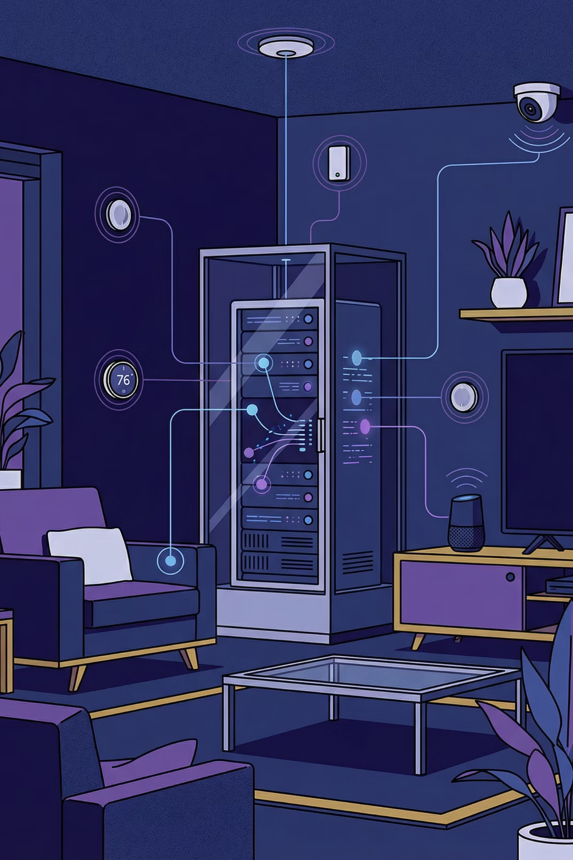
Application of Servers and Unix-like Systems for Sensor Control in Smart Homes
Presented by Weize Yuan
Supervisor: prof. Ing. Miroslav Husák, CSc.
Czech Technical University in Prague
Faculty of Electrical Engineering
2026

Slide 2
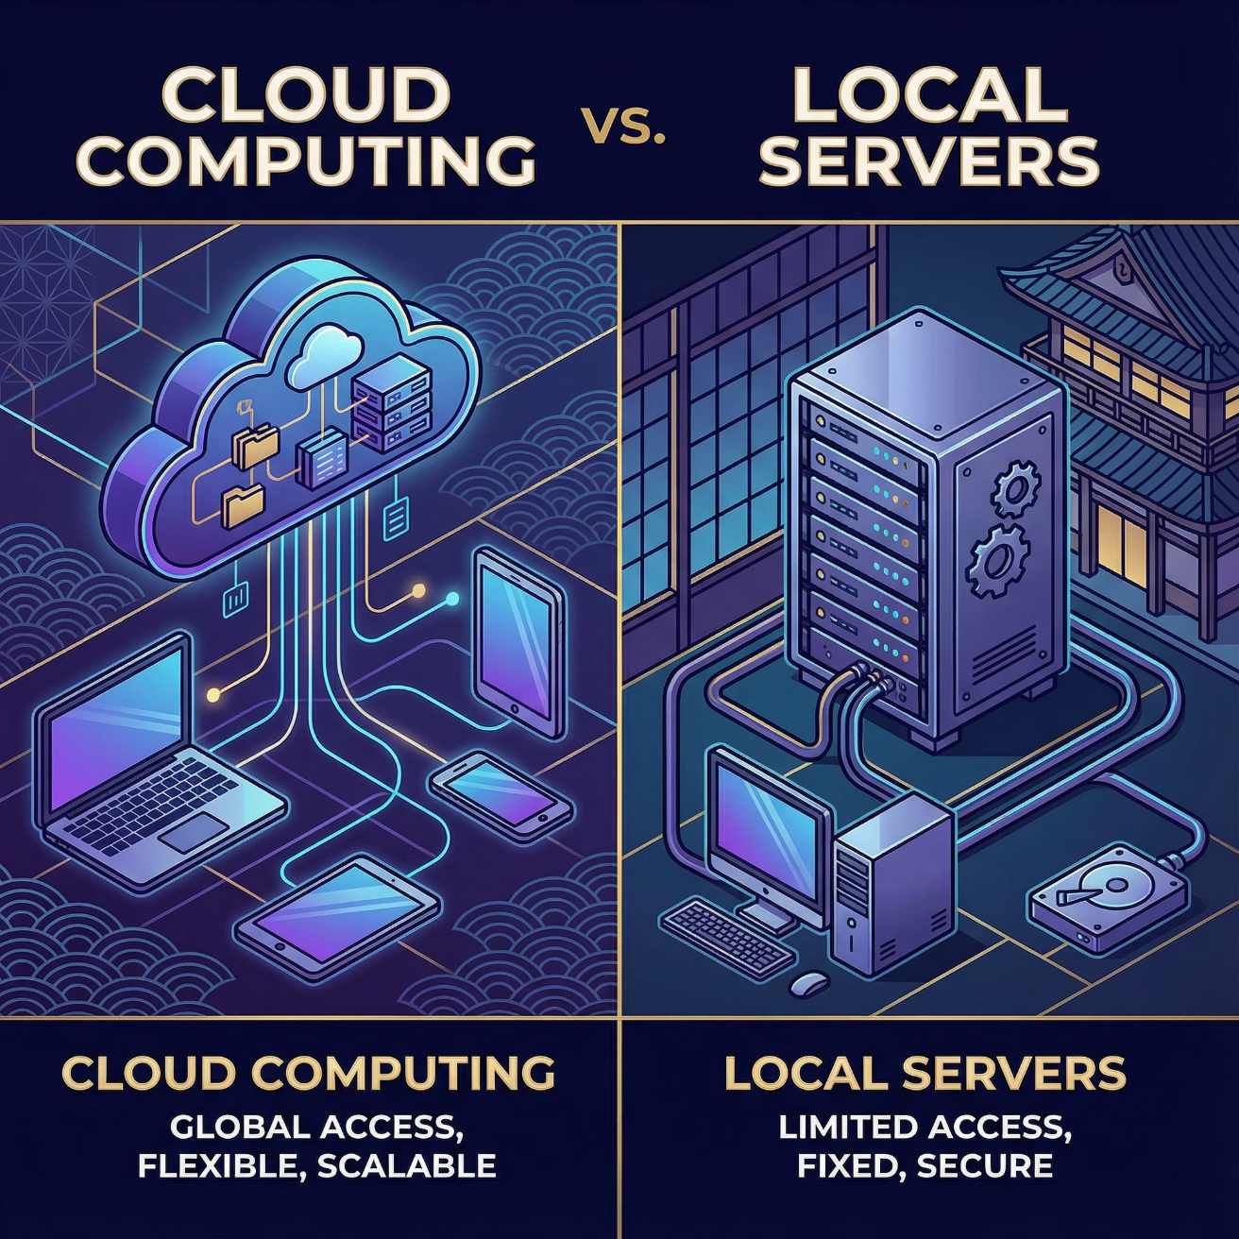
The Smart Home Dilemma: Cloud vs. Local Control
Cloud-based Smart Homes: Inherent Challenges
Local-first Solution: Empowering Users
Privacy Risks
100% Local Data Processing
Data transmitted to and stored on vendor servers, vulnerable to breaches.
All sensitive information remains within the home network.
Vendor Lock-in
Open Standards (MQTT)
Limited to proprietary ecosystems, restricting device choice and interoperability.
Ensuring broad compatibility and future-proofing the system.
Full Customization Control
Internet Dependency
Users have complete autonomy over system configuration and behavior.
Local control often relies on cloud connectivity, failing in outages.
1

Slide 3
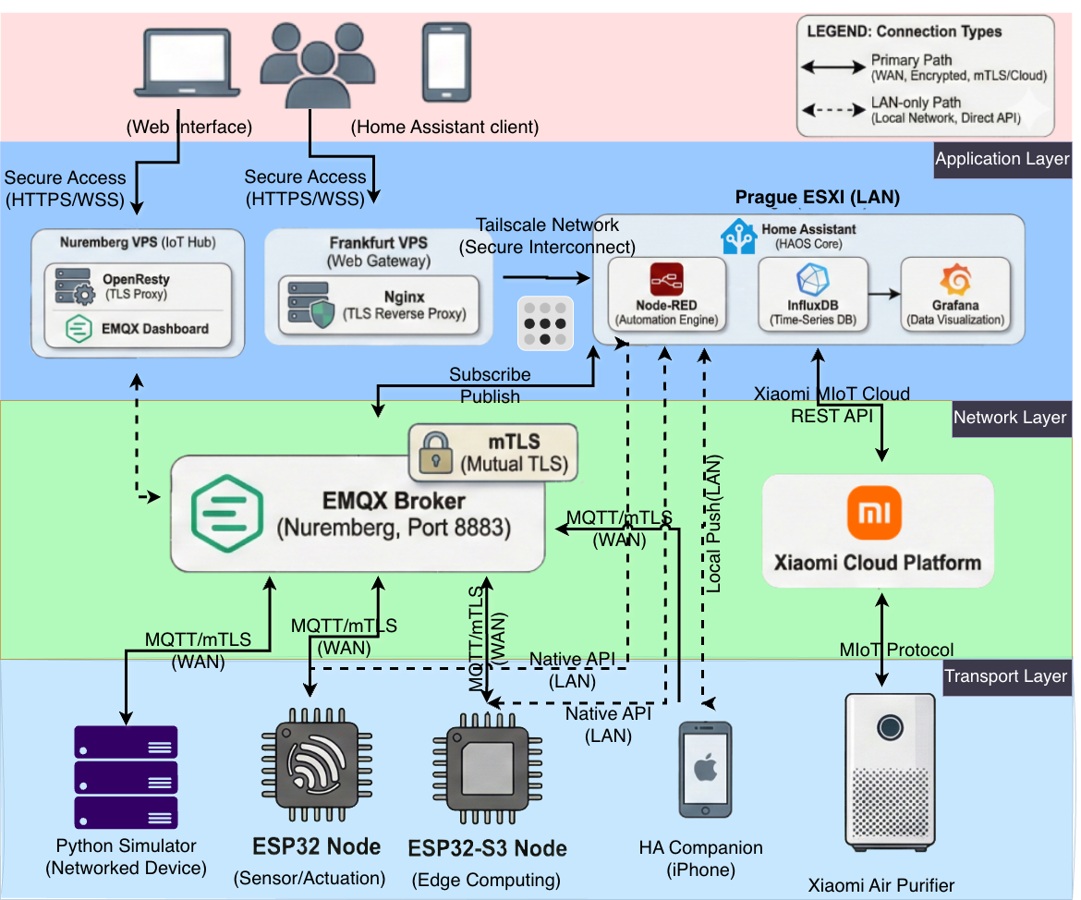

Three-Tiered System Architecture
Our proposed solution is built upon a robust, three-tiered architecture ensuring efficiency, security, and scalability. All processing occurs entirely within the local infrastructure.
Application Layer : Home Assistant OS
Serves as the central automation engine and provides a user-friendly interface for control and monitoring.
Network Layer : EMQX MQTT Broker
Handles secure message routing with mTLS authentication (ECDSA P-256) and Quality of Service (QoS) guarantees.
Transport Layer : ESP32/ESP32-S3 Sensor Nodes
Edge computing capabilities, such as fall detection, run directly on the device. Supports integration of multiple sensors.
2

Slide 4
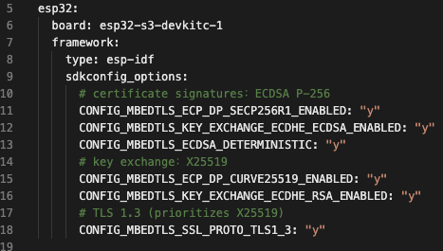
Security Architecture:
Our security design prioritizes robust protection within embedded system constraints.
Cryptographic Choices
ECDSA P-256 for certificate signatures
Engineering Rationale
X25519 for secure key exchange
TLS 1.3 support enabled for enhanced security
ECDSA P-256
Mutual authentication (client and server verification)
Excellent performance
TLS 1.3
Provides forward secrecy and reduced handshake latency for faster, more secure connections.
Mutual TLS
Each device uses a unique certificate, allowing targeted revocation without system-wide impact.
This design balances security standards with embedded constraints and performance requirements.
3

Slide 5
System Integration: MQTT Architecture Design
Our MQTT topic design ensures scalability and seamless integration with Home Assistant.
homeassistant/{domain}/{device_id}/{config/state}
Example Topics
1
2
homeassistant/sensor/esp32s3_temp/state
A standardized topic design pattern for
consistent communication.
homeassistant/binary_sensor/fall_alert/state
Design Benefits
My Work
Scalability: Effortless addition of new devices without schema changes.
Designed topic hierarchy for multi-device scaling.
Implemented HA discovery payloads (JSON schemas).
Home Assistant Auto-Discovery: Devices publish configuration once, HA creates entities automatically.
Configured QoS policies per message type.
Namespace Isolation: Prevents device conflicts.
QoS Support: Critical alerts use QoS 1, sensor data uses QoS 0 for reliability.
4

Slide 6

Hardware Integration: ESP32-S3 Sensor Nodes
Our ESP32-S3 nodes integrate various sensors via I2C Bus and ADC for comprehensive environmental monitoring.
Integrated Sensors
Edge Computing: Fall Detection
MPU6050 (0x68): 6-axis IMU (accelerometer + gyroscope)
The fall detection algorithm runs locally on the device, ensuring immediate response and data privacy.
BMP180 (0x77): Temperature and atmospheric pressure
ADC (GPIO6): Acoustic sensor (KY-037)
Thresholds: 2.4 G acceleration + 240°/s angular velocity
MQ-2: Gas detection (smoke, propane, methane)
Reference: Huynh et al., J. Sensors, 2015
TCS34725: RGB color sensing
Sensitivity: 96.3%, Specificity: 96.2%
The firmware, comprising 266 lines within the ESPHome framework, is detailed in esphome/esp32s3.yaml.
5

Slide 7
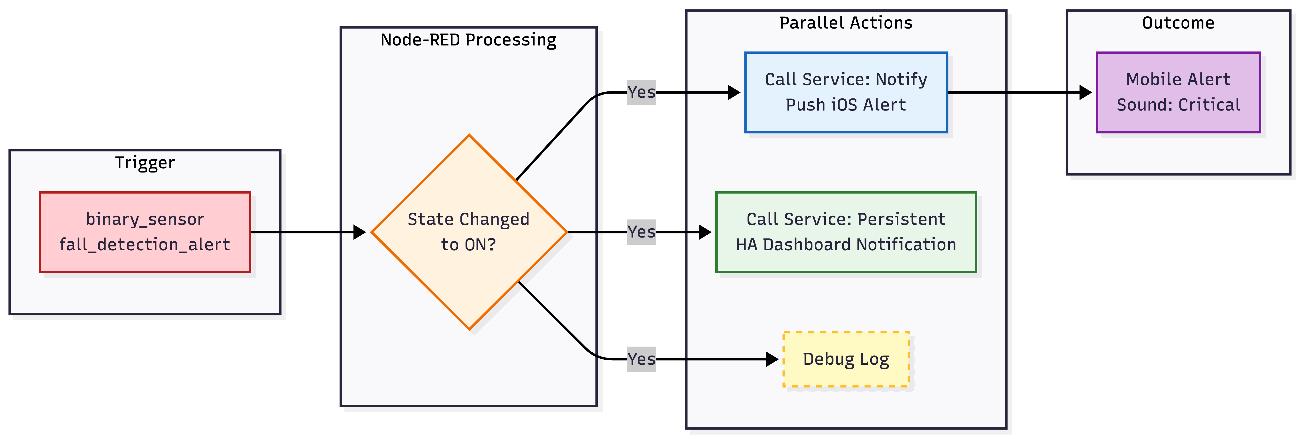
Fall Detection Algorithm: Edge Implementation
The fall detection algorithm is executed directly on the ESP32-S3, leveraging edge computing benefits.
01
Data Sampling
Accelerometer and gyroscope sampled.
02
Magnitude Calculation
Resultant acceleration magnitude (G-force) and angular velocity magnitude calculated.
03
Trigger Condition
Alert triggered if SMV > 2.4 G AND ω > 240 deg/s.
04
Alert Hold
Alert maintained for 5 seconds to ensure notification.
Key Point: Processing happens ON DEVICE
No cloud latency for critical events.
Privacy-preserving: Raw data remains local.
Network efficiency: Only alerts are sent, not continuous raw data.
6

Slide 8
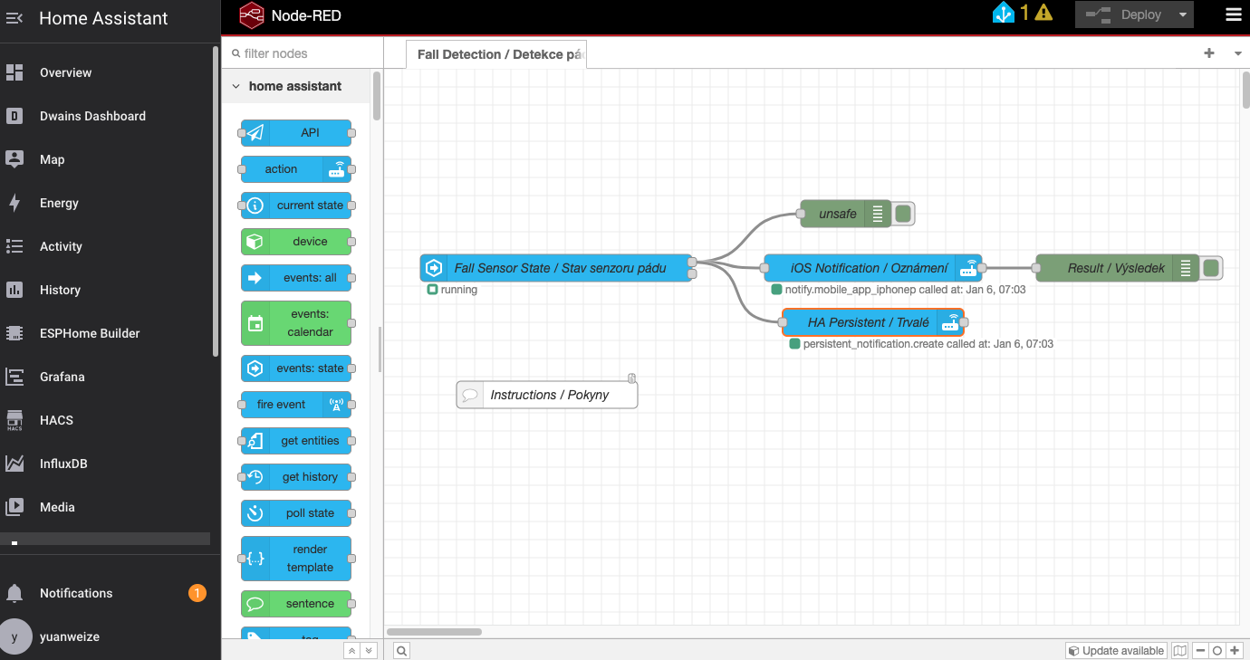
7

Slide 9
Scalability Testing
The Python simulator was used to evaluate system scalability by progressively increasing the number of simulated devices. Each test configuration was monitored for approximately 5 minutes to capture steady-state resource utilization.
Test Methodology
Progressive device scaling from 100 to 1,000 concurrent simulated devices
5-minute monitoring period per configuration to capture steady-state metrics
Monitoring data collected from EMQX Dashboard, broker system metrics, and Home Assistant
Performance Results
Devices
Messages/sec
Broker CPU (%)
HA CPU (%)
100
~229
3.72
1.1
1,000
~1,618
4.03
1.4
8

Slide 10

Platform Analysis
Comparative Matrix: Control vs. Convenience
Evaluation Criterion
Self-Hosted System
Commercial Platforms
(Xiaomi/Alexa/Google)
Data Storage Location
Local Infrastructure(Secure)
Cloud-Dependent
(Vulnerable)
Privacy Control
Complete Ownership
Limited User Control
Offline Functionality
Full Operation
Partial/Minimal
Vendor Independence
Open Source(No Lock-in)
Proprietary Ecosystem
(Complete Lock-in)
Initial Setup Complexity
Medium Engineering Effort
Low (Plug & Play)
Strategic Trade-off Acknowledgment
While self-hosting requires more initial setup, it guarantees total data ownership and zero vendor lock-in. Unlike commercial platforms, this open-source approach ensures long-term stability regardless of external business changes.
9

Slide 11




Core Contributions & Future Improvements
Hardware + Firmware Engineering
Security Architecture Design
System Integration Engineering
Developed ESP32/ESP32-S3 firmware, multi-sensor integration, and edge-based fall detection.
Implemented a robust PKI with ECDSA P-256, mTLS, and automated certificate generation.
Designed scalable MQTT topic hierarchy, Home Assistant auto-discovery, and a Python MQTT simulator.
Technical Roadmap
Research Extensions
On-device activity recognition using TFLite Micro.
Exploring federated learning for privacy-preserving ML.
3D print shell
Implementing time-series databases for advanced analytics.
5G/ 4G module
Kubernetes deployment for multi-home management solutions.
Long-term reliability testing (6+ months uptime).
Energy optimization with deep sleep modes for battery-powered nodes.
Thank You
Questions?
Weize Yuan
yuanweiz@fel.cvut.cz
GitHub: https://github.com/yuanweize/SmartHome_Server/
10

